Slide 1


Artificial Intelligence: The Future of Technology
Artificial Intelligence (AI) is a transformative force reshaping industries and the way we live. Its impact spans from automating routine tasks to pioneering innovations across healthcare, transportation, and finance. The technology's influence is vast, with an expected contribution of $15.7 trillion to the global economy by 2030.
The adoption of AI is projected to grow at a robust compound annual growth rate (CAGR) of 38.1% from 2024 to 2030, signaling widespread integration into many facets of business and daily life.
by Rishav Jha

Slide 2



What is Artificial Intelligence?
Artificial Intelligence is the simulation of human intelligence in machines designed to perform tasks usually requiring human cognition. It encompasses technologies enabling computers to learn, reason, and understand language.
Machine Learning
Deep Learning
Natural Language Processing
Algorithms learning from data without explicit instructions.
Neural networks with multiple layers detecting complex patterns.
Enabling machines to comprehend and generate human language.

Slide 3

AI in Healthcare
AI-Powered Diagnostics
Achieves up to 85% accuracy in detecting early-stage cancers, boosting chances of successful treatment.
Personalized Medicine
Treatments are tailored to individuals based on their unique genetic profiles for better outcomes.
Robotic Surgery
Enhances surgical precision while minimizing invasiveness, reducing patient recovery time.
Drug Discovery
Accelerates drug development timelines by 40%, bringing therapies to market faster.

Slide 4

AI in Transportation
1
Autonomous Vehicles
Projected to reduce traffic fatalities by 90%, improving safety tremendously.
2
Smart Traffic Management
Optimizes traffic flow to decrease congestion by approximately 25%, easing urban commutes.
3
AI-Powered Logistics
Enhances supply chain efficiency by 15%, reducing costs and delivery times.
4
Drone Delivery
Enables faster, more efficient package deliveries, improving last-mile logistics.

Slide 5

AI in Finance
Algorithmic Trading
Generates returns approximately 20% higher than traditional investment methods through AI analysis.
Fraud Detection
Reduces fraudulent transactions by 70%, safeguarding financial systems and customers.
Robo-Advisors
Provide personalized, cost-effective financial advice accessible to a broader audience.
Risk Assessment
Improves credit scoring accuracy by 30%, enabling fairer lending decisions.

Slide 6
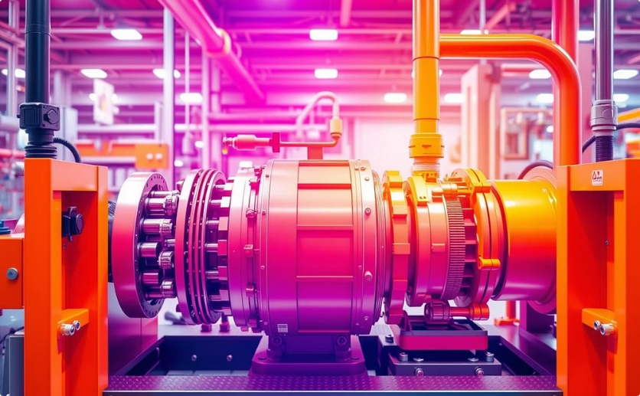
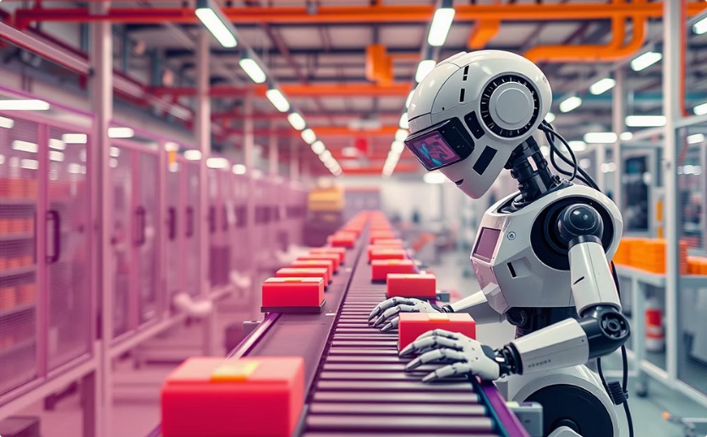
AI in Manufacturing
Predictive Maintenance
Quality Control & Automation
AI predicts equipment failures, cutting downtime by 40% and saving costs.
AI reduces defects by 60% through precise inspections.
Automation increases productivity and lowers labor costs by 25%.
Keeps production lines running smoothly without surprises.
Optimized supply chain allocation cuts expenses.

Slide 7
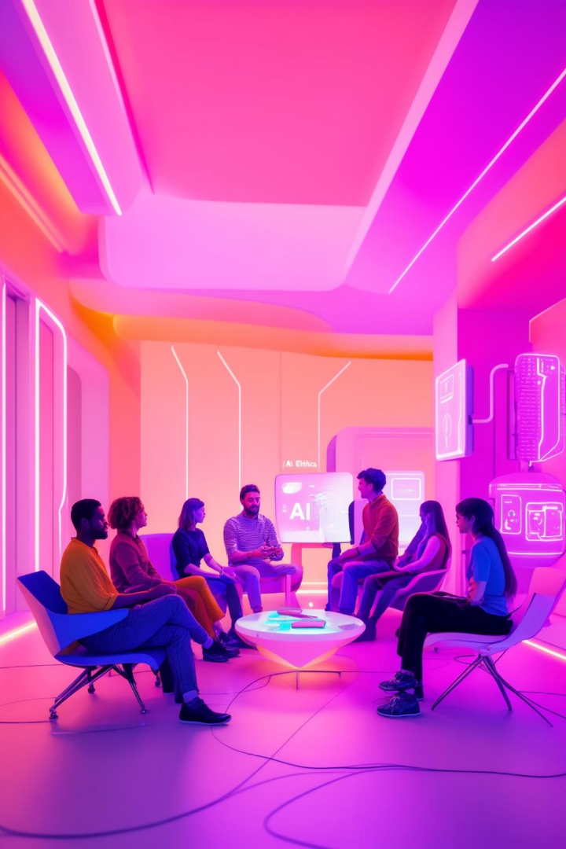




Ethical Considerations
Bias in AI Algorithms
Addressing potential biases to prevent unfair or discriminatory outcomes in AI decision-making.
Job Displacement
Managing workforce impact by reskilling and creating new job opportunities aligned with AI advancements.
Privacy Concerns
Ensuring personal data protection and responsible use to maintain user trust.
Transparency & Accountability
Developing explainable AI models to build trust and facilitate responsible governance.

Slide 8

Challenges and Limitations
Data Dependency
AI requires vast amounts of high-quality data to train effective models, which can be a bottleneck.
Computational Resources
Training deep learning models demands significant computing power and energy consumption.
Lack of Interpretability
Understanding AI decision processes remains challenging, raising concerns about trust.
Security Vulnerabilities
AI systems must be safeguarded against cyberattacks that could exploit weaknesses.

Slide 9




The Future of AI
Rapid Adoption
Technology Integration
AI growth will continue at a 38.1% CAGR through 2030, expanding into diverse sectors.
1
Combining AI with IoT, blockchain, and 5G will multiply capabilities and create new applications.
2
Advancements in Learning
Ethical Development
4
Innovations in machine and deep learning will produce more sophisticated and autonomous AI systems.
A growing emphasis on responsible AI will ensure fairness, transparency, and societal benefit.
3

Slide 10

Conclusion: Embracing the AI Revolution
Transforming Industries
AI is set to revolutionize sectors, unlocking unprecedented innovation and operational efficiency.
Unlocking Opportunities
Organizations embracing AI can drive growth and deliver positive societal impact in new ways.
Collaboration & Responsibility
Developing AI with ethical principles and cross-sector collaboration is essential for success.
Shaping the Future
Together, we can harness AI to build a future that benefits all of humanity.

